Slide 1
CH-20 INTRO TO NETWORK LAYER
Section 2

Slide 2
CONTENT
Introduction
Distance-Vector Routing
- Bellman-Ford Equation.
- Distance Vectors.
- Distance-Vector Routing Algorithm.
Link-State Routing
- Link-State Database (LSDB).
- Formation of Least-Cost Trees.
Path-Vector Routing
- Spanning Trees.
- Creation of Spanning Trees.
- Path-Vector Algorithm.

Slide 3
INTRODUCTION
An internet is a combination of networks connected by routers. When a datagram goes from a source to a destination, it will probably pass through many routers until it reaches the router attached to the destination network.

Slide 4
INTER AND INTRA-DOMAIN ROUTING
Today, an internet can be so large that one routing protocol cannot handle the task of updating the routing tables of all routers. For this reason, an internet is divided into autonomous systems.
An autonomous system (AS) is a group of networks and routers under the authority of a single administration. Routing inside an autonomous system is called intra-domain routing. Routing between autonomous systems is called inter-domain routing

Slide 5
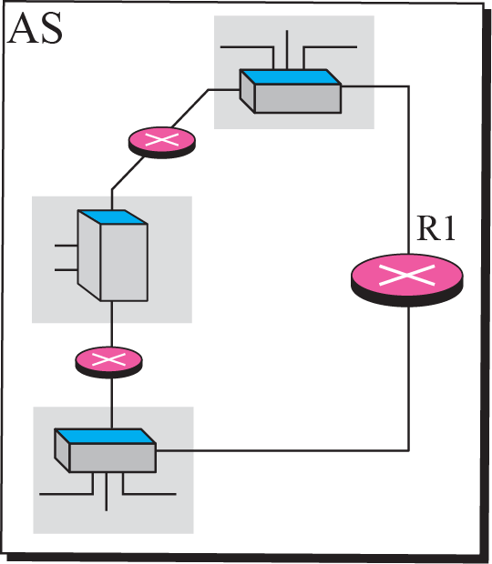
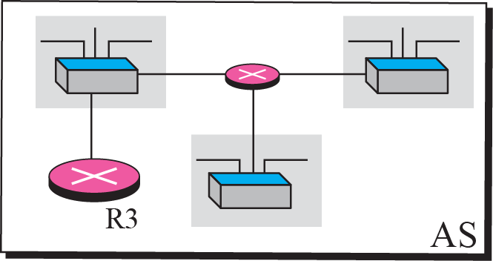
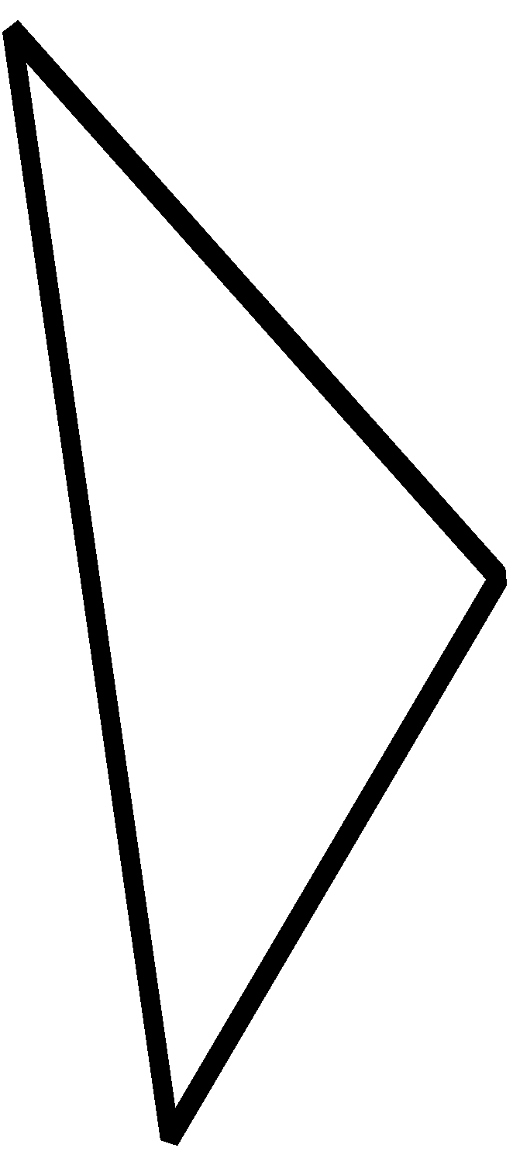
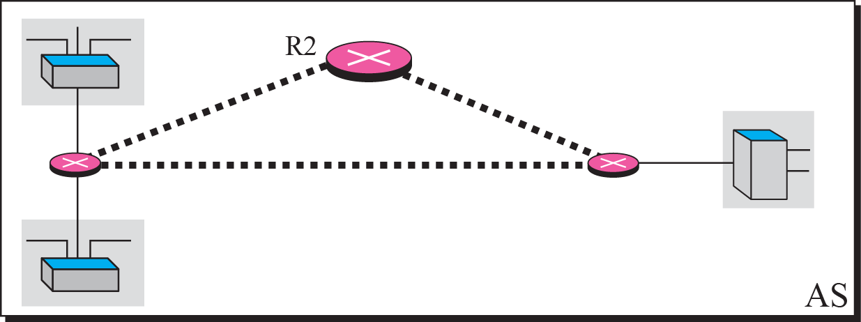
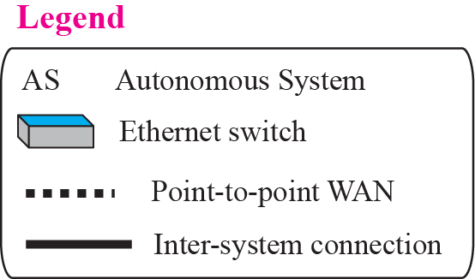
AUTONOMOUS SYSTEMS

Slide 6
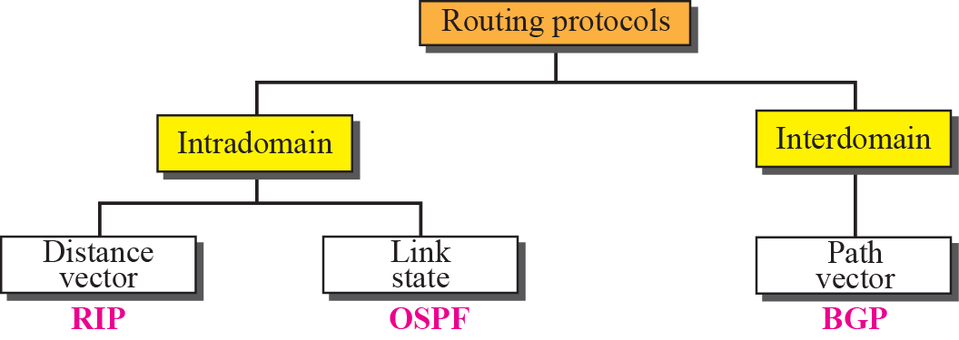
POPULAR ROUTING PROTOCOLS

Slide 7
DISTANCE-VECTOR ROUTING
The distance-vector (DV) routing uses the goal to find the best route.
The first thing each node creates is its own least-cost tree with the rudimentary information it has about its immediate neighbors.
The incomplete trees are exchanged between immediate neighbors to make the trees more and more complete and to represent the whole internet.
router continuously tells all of its neighbors what it knows about the whole internet,
(although the knowledge can be incomplete).

Slide 8
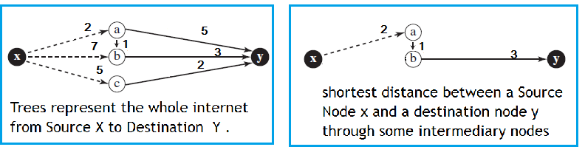
BELLMAN-FORD EQUATION
Bellman-Ford equation is used to find the least cost (shortest distance) between a source node x and a destination node y through some intermediary nodes (a, b, c, . . .) when the costs between the source and the intermediary nodes and the least costs between the intermediary nodes and the destination are given.
Equation

Slide 9
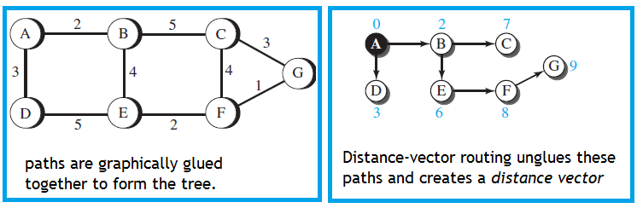
DISTANCE VECTORS
A least-cost tree is a combination of least-cost paths from the root of the tree to all destinations.
These paths are graphically glued together to form the tree.
Distance-vector routing unglues these paths and creates a distance vector, a one-dimensional array to represent the tree.

Slide 10
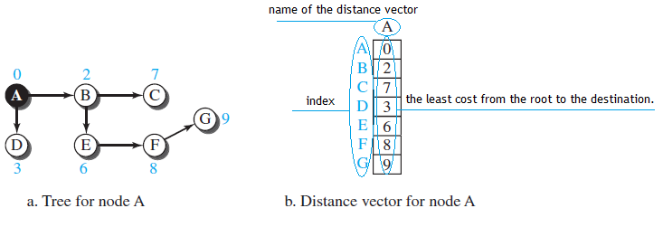
DISTANCE VECTORS
Note That :
The name of the distance vector defines the root.
The indexes define the destinations.
The value of each cell defines the least cost from the root to the destination.

Slide 11
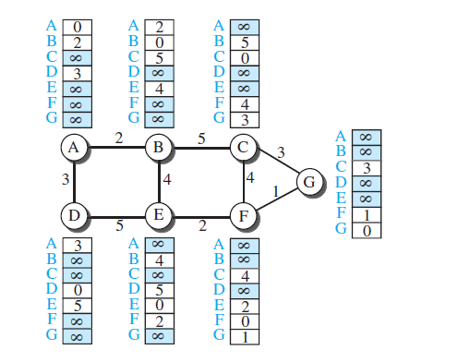
HOW EACH NODE IN AN INTERNET ORIGINALLY CREATES THE CORRESPONDING VECTOR ?
1 - Each node in an internet, when it is booted, creates a very rudimentary distance vector with the minimum information the node can obtain from its neighborhood.

Slide 12
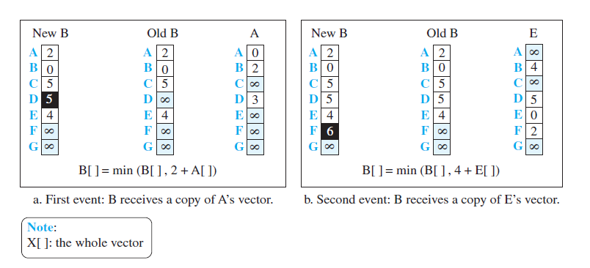
HOW EACH NODE IN AN INTERNET ORIGINALLY CREATES THE CORRESPONDING VECTOR ?
The node sends some greeting messages out of its interfaces and discovers the identity of the immediate neighbors and the distance between itself and each neighbor.
makes a simple distance vector by inserting the discovered distances in the corresponding cells and leaves the value of other cells as infinity.

Slide 13
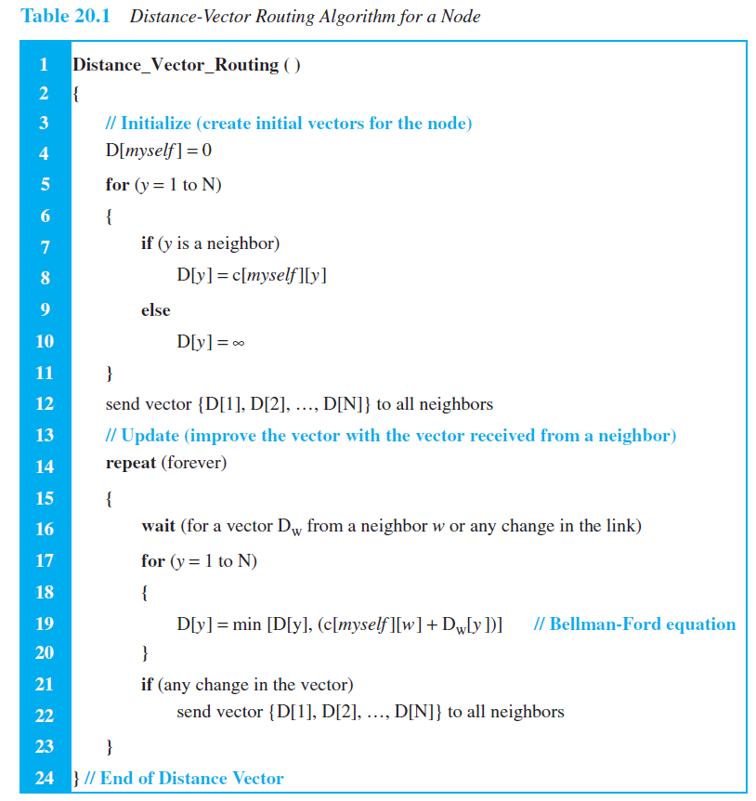
DISTANCE-VECTOR ROUTING ALGORITHM

Slide 14
COUNT TO INFINITY
A problem with distance-vector routing is that any decrease in cost (good news) propagates quickly, but any increase in cost (bad news) will propagate slowly.
For a routing protocol to work properly, if a link is broken (cost becomes infinity),
every other router should be aware of it immediately, but in distance-vector routing, this takes some time.
The problem is referred to as count to infinity.
It sometimes takes several updates before the cost for a broken link is recorded as infinity by all routers.

Slide 15
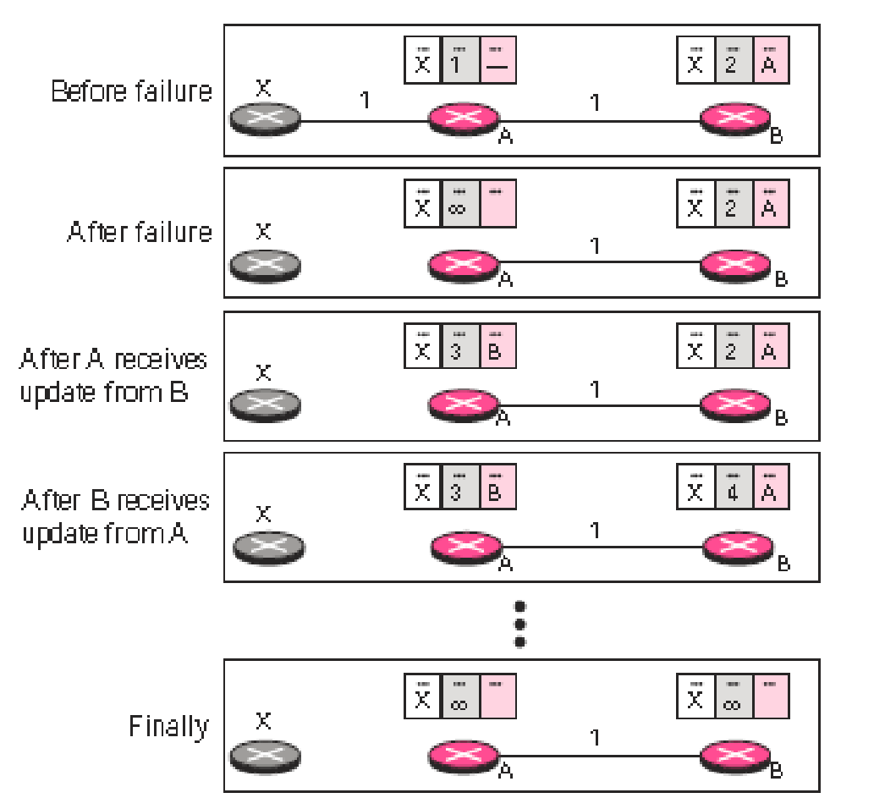
COUNT TO INFINITY

Slide 16
SPLIT HORIZON
In this strategy, instead of flooding the table through each interface, each node sends only part of its table through each interface.
If, according to its table, node B thinks that the optimum route to reach X is via A.
Taking information from node A, modifying it, and sending it back to node A is what creates the confusion.
In this case, node A keeps the value of infinity as the distance to X.
Later, when node A sends its forwarding table to B, node B also corrects its forwarding table.
The system becomes stable after the first update: both node A and node B know that X is not reachable.

Slide 17
POISON REVERSE
Using the split-horizon strategy has one drawback.
Normally, the corresponding protocol uses a timer, and if there is no news about a route, the node deletes the route from its table.
When node B in the previous scenario eliminates the route to X from its advertisement to A, B has not received any news about X recently.
In the poison reverse strategy B can still advertise the value for X, but if the source of information is A, it can replace the distance with infinity as a warning: “Do not use this value”.
if the instability is between three nodes, stability cannot be guaranteed.

Slide 18
LINK-STATE ROUTING
A routing algorithm that directly follows our discussion for creating least-cost trees and forwarding tables is link-state (LS) routing.
This method uses the term link-state to define the characteristic of a link (an edge) that represents a network in the internet.
Links with lower costs are preferred to links with higher costs.
if the cost of a link is infinity, it means that the link does not exist or has been broken.

Slide 19
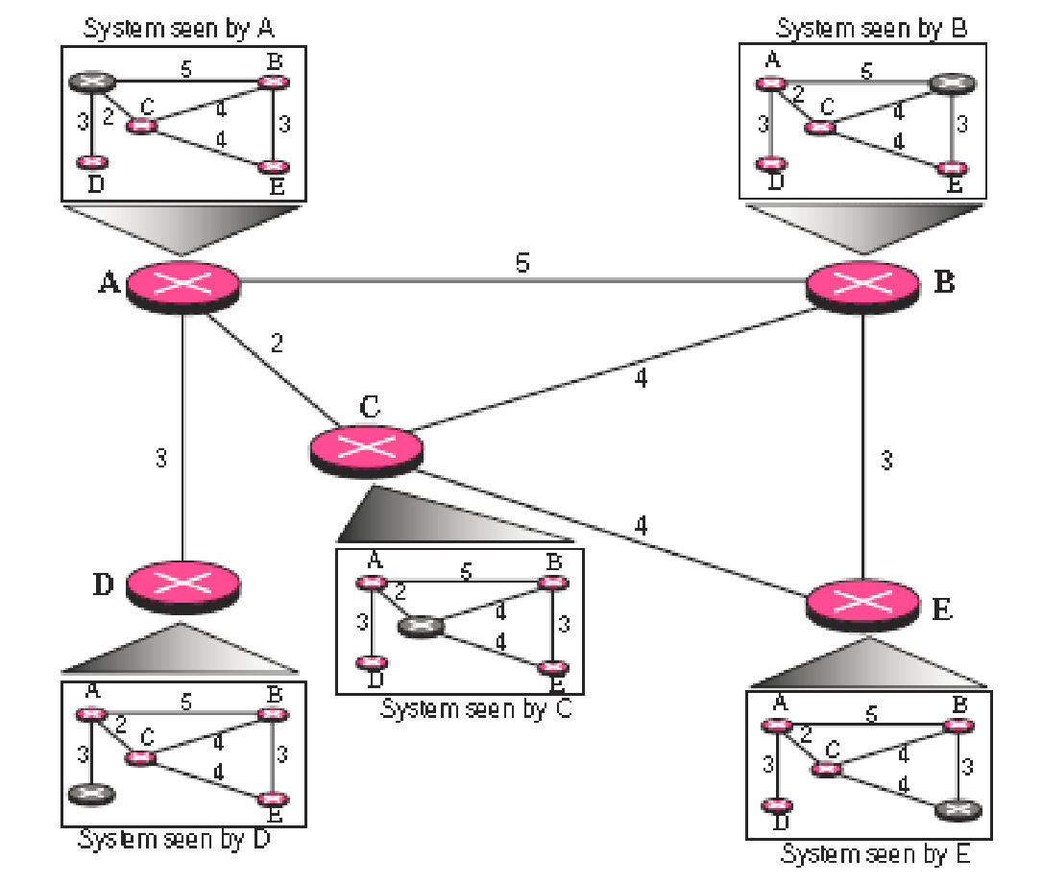
LINK STATE ROUTING

Slide 20
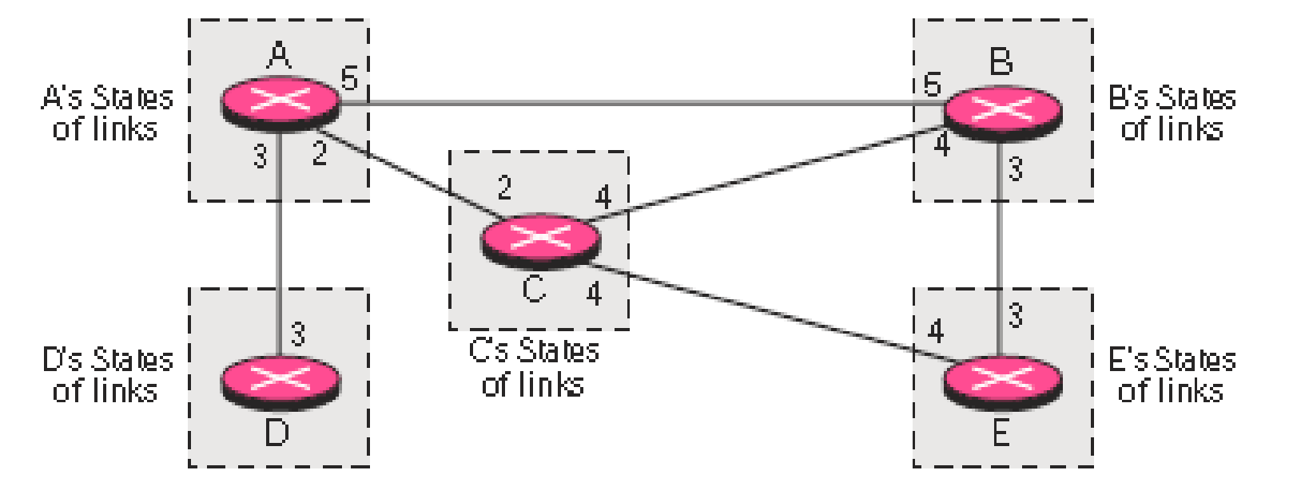
LINK STATE KNOWLEDGE

Slide 21
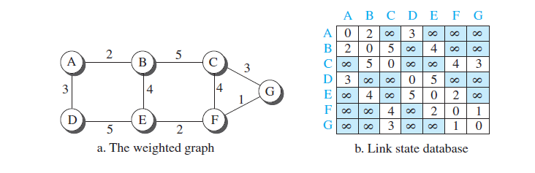
LINK STATE DATABASE (LSDB)
To create a least-cost tree with this method, each node needs to have a complete map of the network, which means it needs to know the state of each link.
There is only one LSDB for the whole internet.

Slide 22
LINK STATE DATABASE (LSDB)
how each node can create this LSDB that contains information about the whole internet?
This can be done by a process called flooding.
Each node can send some greeting messages to all its immediate neighbors to collect two pieces of information for each neighboring node:
-The identity of the node.
-The cost of the link.
The combination of these two pieces of information is called the LS packet (LSP).
The LSP is sent out of each interface, as shown in Figure 20.9 for our internet in Figure 20.

Slide 23
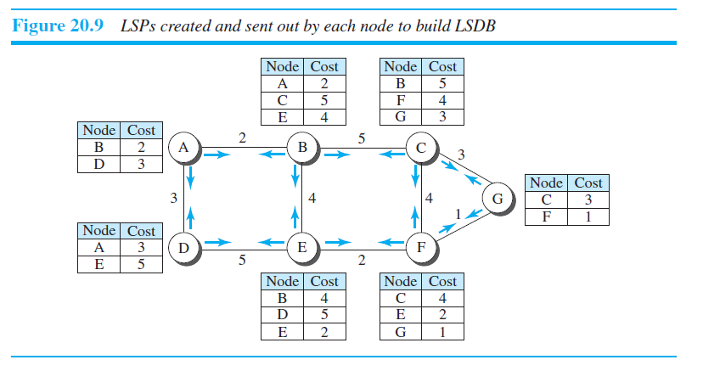
LINK STATE DATABASE (LSDB)

Slide 24
LINK STATE DATABASE (LSDB)
When a node receives an LSP from one of its interfaces, it compares the LSP with the copy it may already have.
If the arrived LSP is older than the one it has, it discards the arrived LSP.
If it is newer than the one it has, the node discards the old LSP and keeps the received one.
It then sends a copy of it out of each interface except the one from which the packet arrived.

Slide 25
FORMATION OF LEAST-COST TREES
To create a least-cost tree for itself, using the shared LSDB, each node needs to run the famous Dijkstra Algorithm.
This iterative algorithm uses the following steps:
1. The node chooses itself as the root of the tree, creating a tree with a single node, and sets the total cost of each node based on the information in the LSDB.
2. The node selects one node, among all nodes not in the tree, which is closest to the root, and adds this to the tree.
After this node is added to the tree, the cost of all other nodes not in the tree needs to be updated because the paths may have been changed.
3. The node repeats step 2 until all nodes are added to the tree.

Slide 26
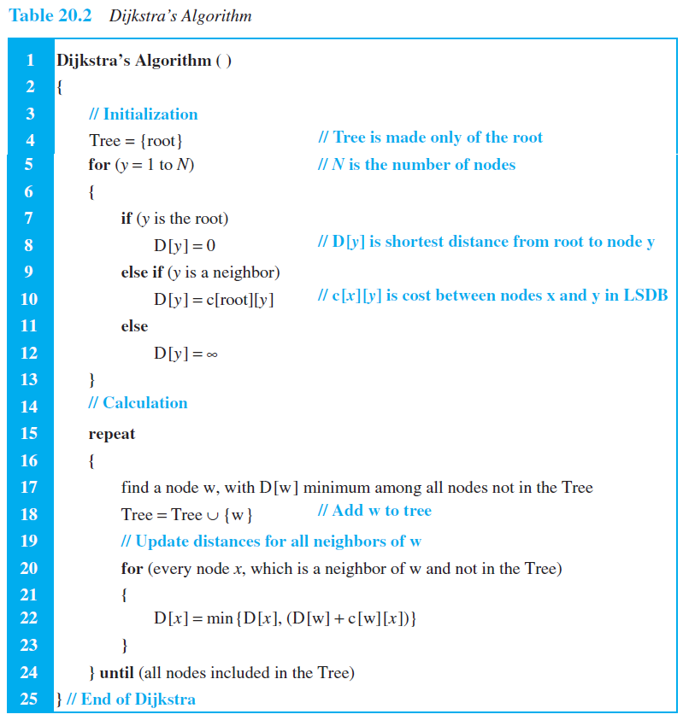
DIJKSTRA’S ALGORITHM

Slide 27
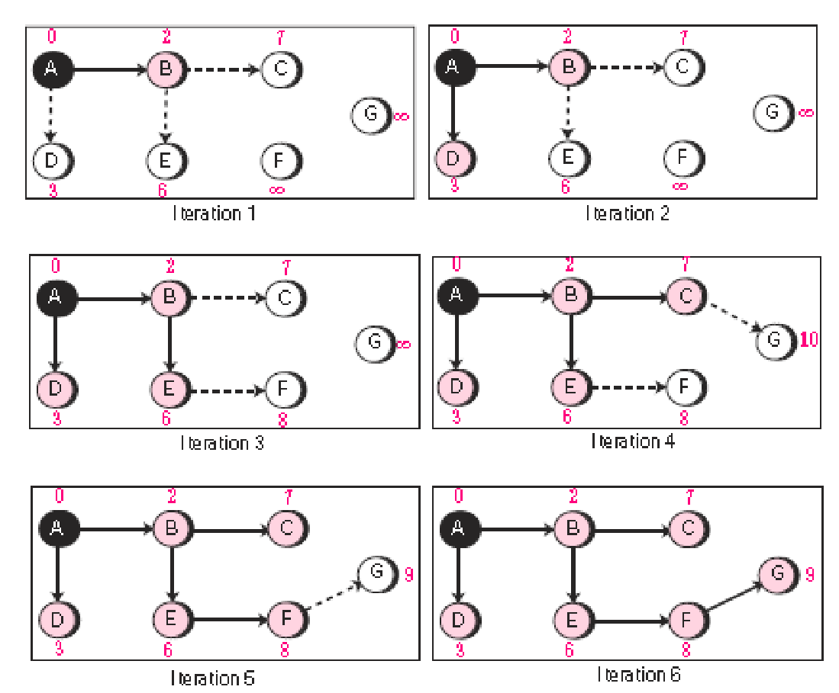
FORMATION OF LEAST-COST TREES

Slide 28
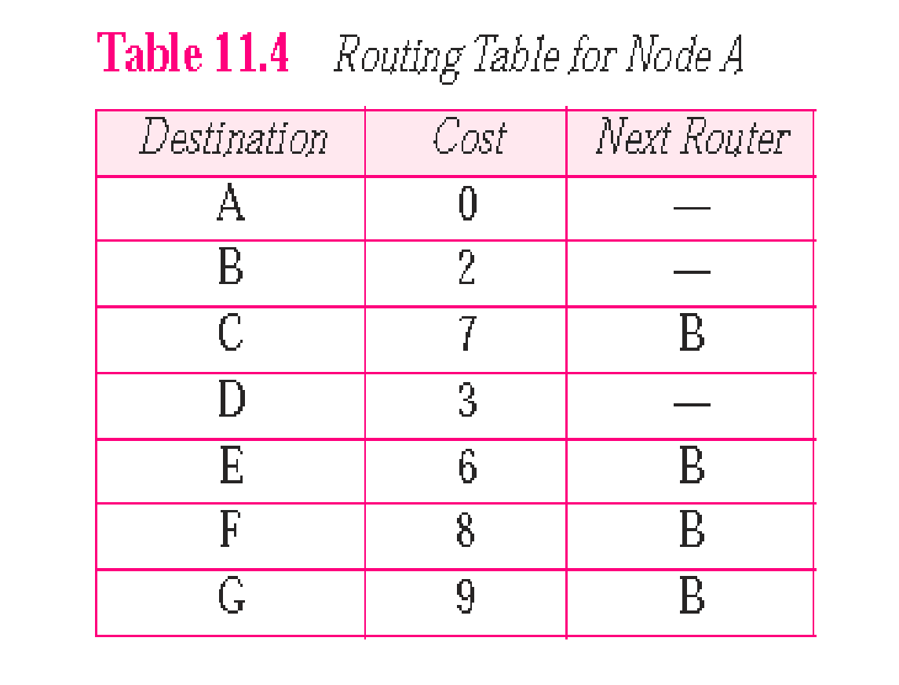
CALCULATION OF ROUTING TABLE

Slide 29
PATH-VECTOR ROUTING
Both link-state and distance-vector routing are based on the least-cost goal.
Least cost goal is not a priority
router may belong to an organization that does not provide enough security, or it may belong to a commercial rival of the sender which might inspect the packets for obtaining information.
Least-cost routing does not prevent a packet from passing through an area when that area is in the least-cost path.

Slide 30
PATH-VECTOR ROUTING
Path-vector routing does not have the drawbacks of LS or DV routing as described above because it is not based on least-cost routing.
The best route is determined by the source using the policy it imposes on the route.
In other words, the source can control the path.
path-vector routing is not actually used in an internet, and is mostly designed to route a packet between ISPs

Slide 31
SPANNING TREES
The tree determined by the source when it imposes its own policy.
If there is more than one route to a destination, the source can choose the route that meets its policy best.
A source may apply several policies at the same time.
One of the common policies uses the minimum number of nodes to be visited.
common policy is to avoid some nodes as the middle node in a route.

Slide 32
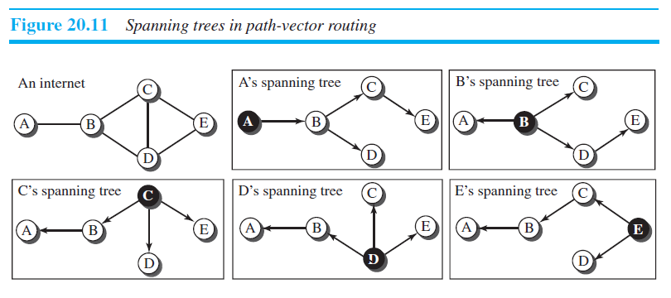
SPANNING TREES IN PATH-VECTOR ROUTING
The policy imposed by all sources is to use the minimum number of nodes to reach a destination.
The spanning tree selected by A and E is such that the communication does not pass through D as a middle node.

Slide 33
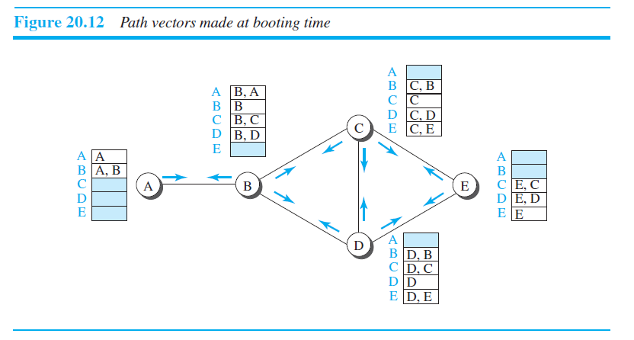
CREATION OF SPANNING TREES
When a node is booted, it creates a path vector based on the information it can obtain about its immediate neighbor.
A node sends greeting messages to its immediate neighbors to collect these pieces of information.

Slide 34
CREATION OF SPANNING TREES
The policy is defined by selecting the best of multiple paths.
Path-vector routing also imposes one more condition on this equation: If Path (x, y) includes x, that path is discarded to avoid a loop in the path.
In other words, x does not want to visit itself when it selects a path to y.

Slide 35
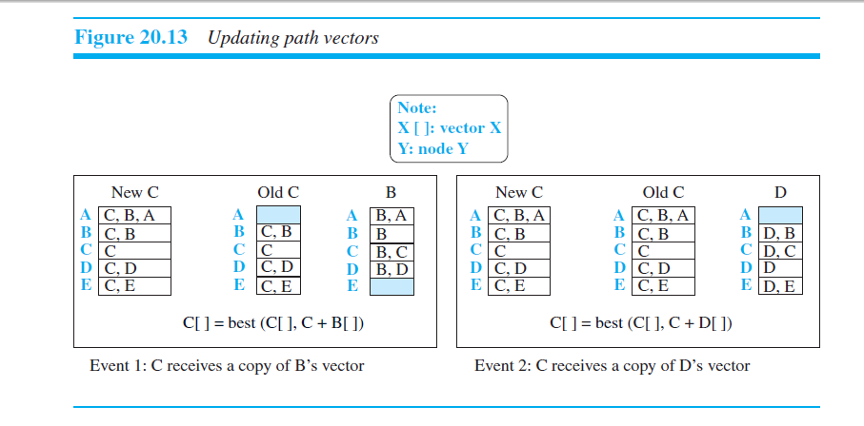
UPDATING PATH VECTORS

Slide 36
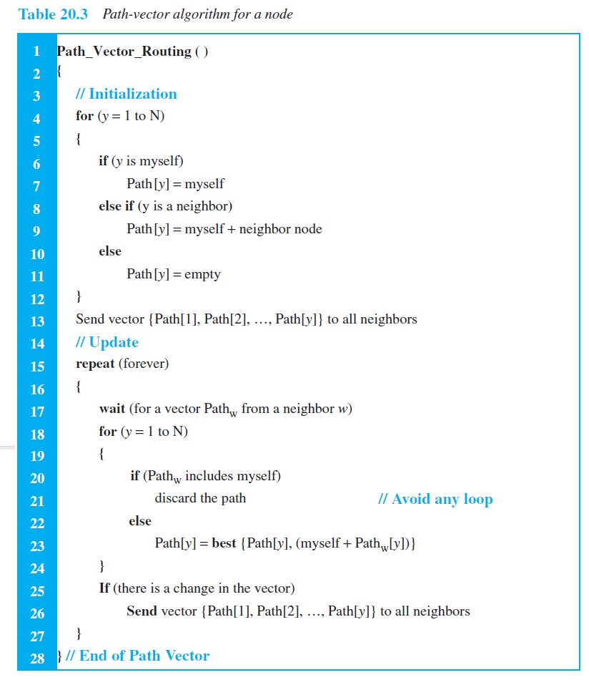
PATH-VECTOR ALGORITHM
NEXT

